Slide 1


Web Server
Configuration
Apache and Nginx Web Server Configuration
Abhihabh Duwal

Slide 2
CONTENTS
1
2
3
Apache Web Server
Nginx Web Server
Nginx Reverse Proxy

Slide 3
Apache
Web Server
  Apache is an open-source web server widely used for hosting dynamic and static websites.
  It supports Virtual Hosts, allowing multiple websites to be hosted on a single server using different ports or domain names.

Slide 4
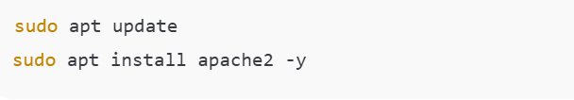
Apache
Step 1: Installation

Slide 5
Apache
Step 2: Port Configuration
File Modified: /etc/apache2/ports.conf

Slide 6
Apache
Step 3: Website Directory & HTML Page

Slide 7
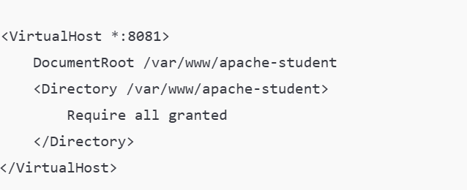
Apache
Step 4: Virtual Host Configuration
File: /etc/apache2/sites-available/apache-student.conf

Slide 8

Apache
Step 5: Enable Site & Output

Slide 9
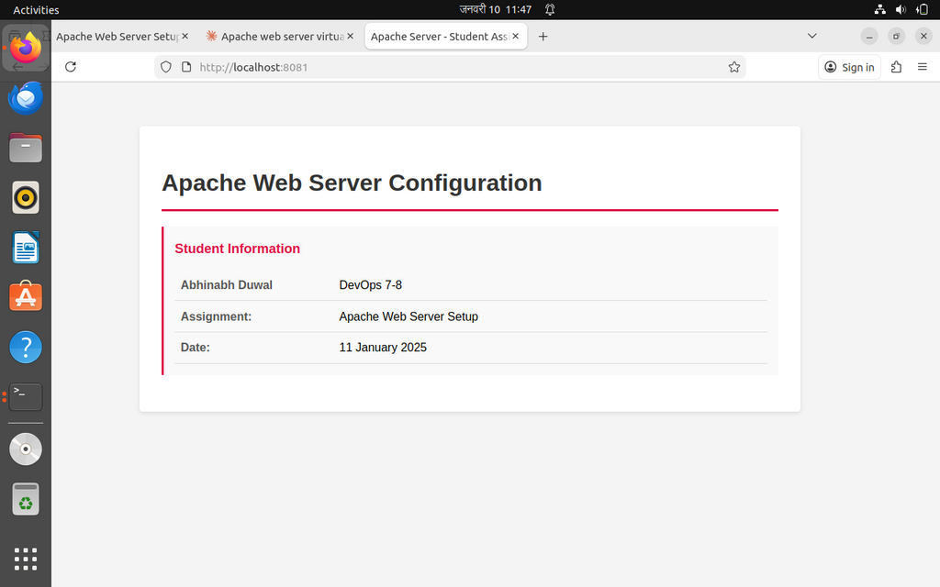
Apache
Output

Slide 10
Nginx
Web Server
  Nginx is a high-performance web server known for speed, scalability, and low memory usage.
  It uses Server Blocks, similar to Apache Virtual Hosts.

Slide 11
Nginx
Step 1: Installation

Slide 12
Nginx
Step 2: Website Directory & HTML Page

Slide 13
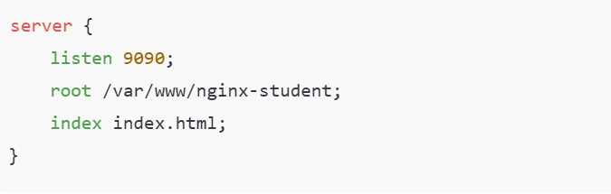
Nginx
Step 3: Server Block Configuration
File: /etc/nginx/sites-available/nginx-student

Slide 14
Nginx
Step 4: Enable Site & Disable Default

Slide 15
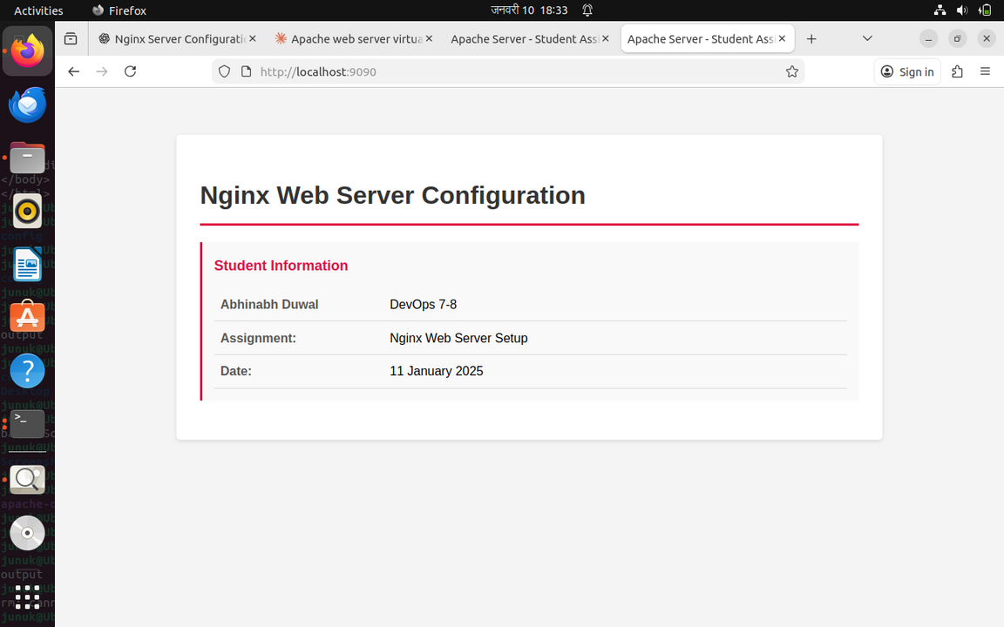
Nginx
Output

Slide 16
Nginx
Nginx Reverse Proxy
  Nginx is a high-performance web server known for speed, scalability, and low memory usage.
  It uses Server Blocks, similar to Apache Virtual Hosts.

Slide 17

Nginx
Step 1: Configure Apache to Run on Port 8080

Slide 18

Nginx
Step 2: Create Apache Backend Web Page

Slide 19
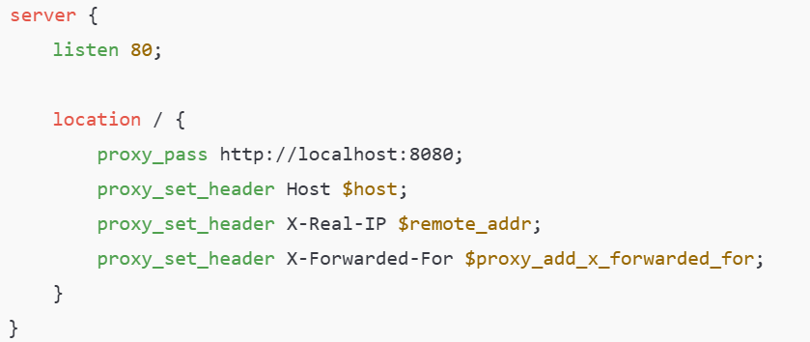
Nginx
Step 3: Create Nginx Reverse Proxy Configuration

Slide 20
Nginx
Step 4: Enable Reverse Proxy Configuration

Slide 21
Conclusion
Apache and Nginx web servers were successfully installed and configured on Ubuntu. Apache served a custom website on port 8081 using a Virtual Host, while Nginx served a website on port 9090 using a custom server block with the default site disabled. Additionally, Nginx was implemented as a reverse proxy on port 80 to forward requests to the Apache backend on port 8080, demonstrating efficient web server management and request handling.

Slide 22
Any questions?

Slide 23
Any questions?
Thank you

